Slide 1
SUNET-dagarna 13/4/2021
Inspera Onboarding

Slide 2
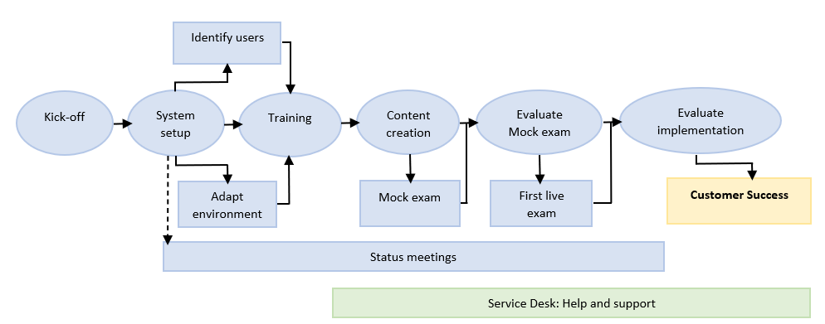
Onboarding
Activity overview
Onboarding and implementation activities are marked in blue.

Slide 3
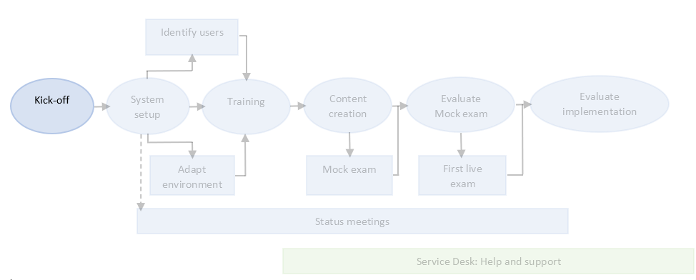
1 Kick-off meeting
Onboarding activity
Introduction of the project
  Project scope / plan
  Planned activities and goals
  Project timeline
Timeline for onboarding activities
Plan for setting up the system

Slide 4
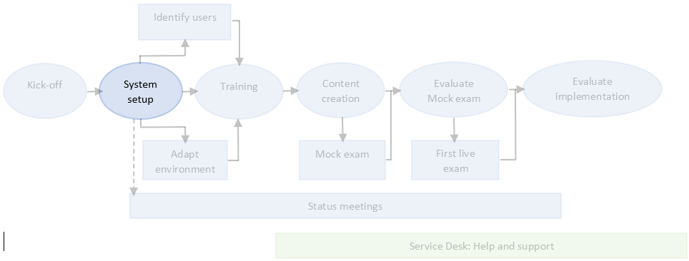
2 System setup
Onboarding activity
Account setup: Customer name and tenant URL (e.g. institutionname.inspera.com
Information architecture: Permissions for user roles, organisation units and defining workflows
Customised options: Personalise your tenant with background image, logo and help text
Additional products: InsperaScan
Standard integrations: Single-Sign On (SSO), Ladok and Inspera API

Slide 5
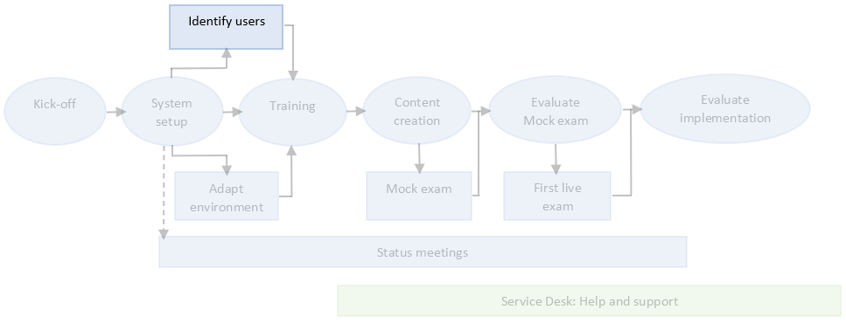
3 Identify users
Onboarding activity
Project team
Super users group
  Staff working in different parts of the organisation
  Administration / exam office
  Graders
  Invigilators
  IT department

Slide 6
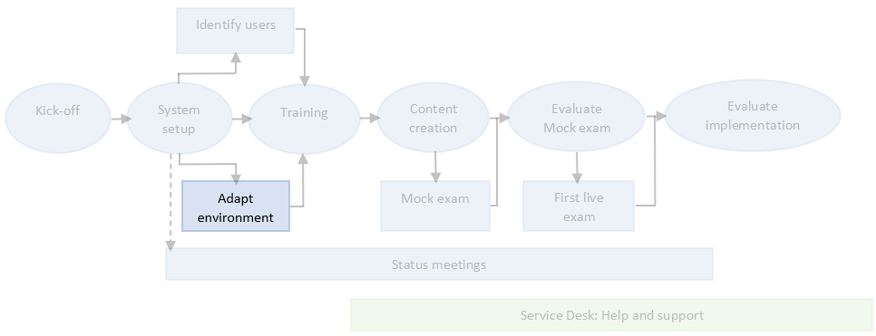
4 Adapt environment
Onboarding activity
Initial account configuration
  Enable / disable configurable system settings
  Available configurations in Inspera Assessment
Customisation of landing page for students and admins (if applicable)

Slide 7
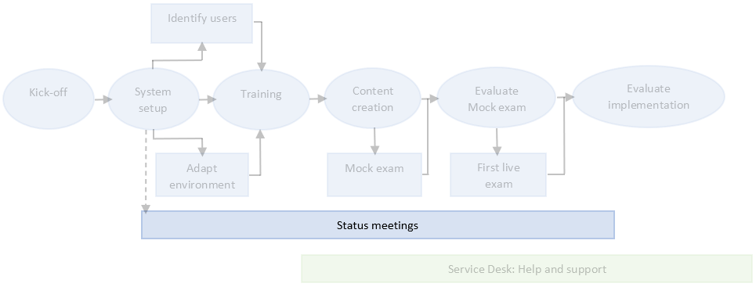
5 Status meetings
Onboarding activity
Customer owned activity
Every second week
Agenda suggestions: Project status, any issues/concerns and questions about functionality
Ends after onboarding is completed → Customer Success

Slide 8
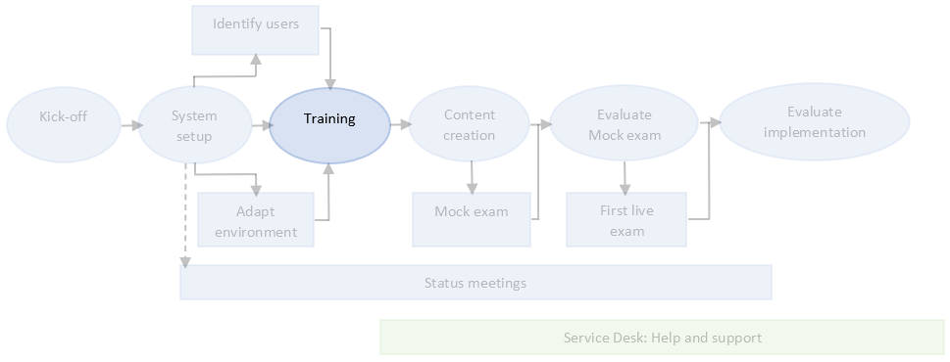
6 Training
Onboarding activity
Carried out after the technical implementation of the system, but can also be ordered if needed at later stages
Training consists of Onboarding training test and four webinars
  Participants conduct the onboarding training test
  The four webinars consists of:
    Author module
    Deliver module
    Monitor module
    Grade module

Slide 9
6 Training
Onboarding training test (4 webinars)
Step 1
Step 2
Step 3
Step 4
Step 5
Training Preparation test
Collect questions
Customise webinars
Training webinars
Prepare Training Preparation test
•Create users on tenant
•Set up Training Onboarding test
•Conduct test
•Do activities
•Write down questions
Customer collects questions from participants and sends them to OC
OC customises webinars based on questions and feedback from customer
Four webinars:
1 Author module (2 hours)
2 Deliver module (1.5 hour)
3 Monitor module (1.5 hour)
4 Grade module (2 hours)

Slide 10
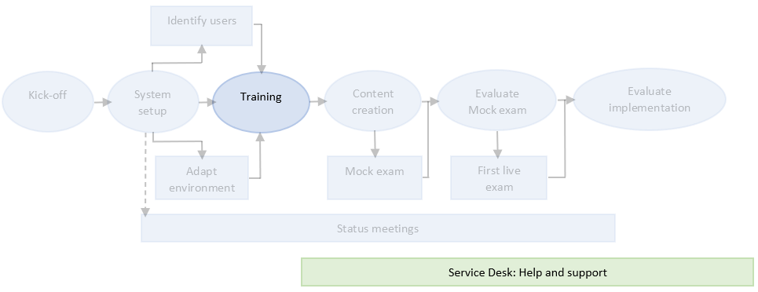
6 Training
After training: Get access to Service Desk (Inspera Support)
After training and before the first live exam
Service Desk is dedicated to help with questions and assist with technical troubleshooting
Submit support requests, feature requests, service requests and report issues

Slide 11
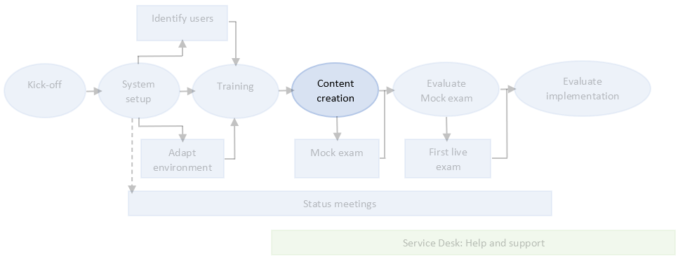
7 Content creation
Onboarding activity
Customer owned activity
Make guidelines and/or make a content creation plan
  Naming of questions and questions sets
  Use of design settings on question sets
  Test naming and settings
  Student information
Create questions, question sets and tests

Slide 12
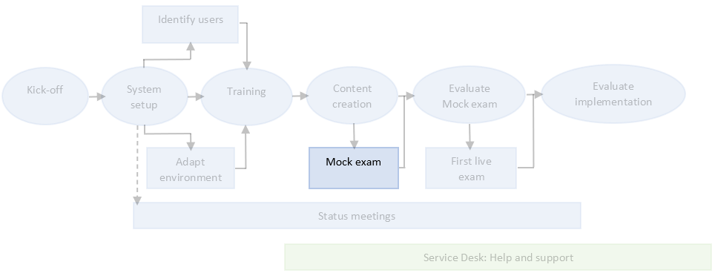
8 Mock exam
Onboarding activity
Customer owned activity
Make sure that you are ready to go live with a digital exam process
Full test of end-to-end workflow
  Planning
  Exam day routines
  Single-Sign On (SSO)
  Test delivery
  Marking
  Exam data analysis

Slide 13
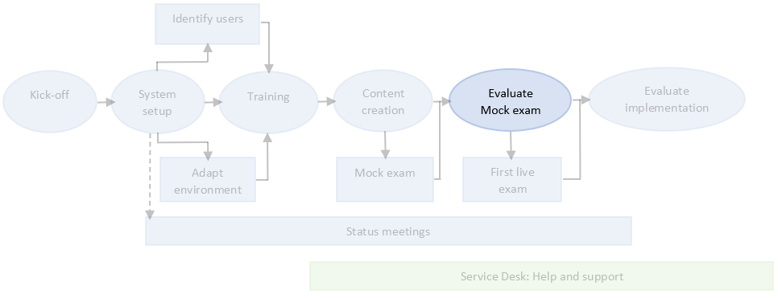
9 Evaluate mock exam
Onboarding activity
Customer owned activity
Evaluate the results from the mock exam
Perform any needed adjustments
  Training of other admin users
  Process engineering
  Hardware
  Guides for staff
  Guides for students

Slide 14
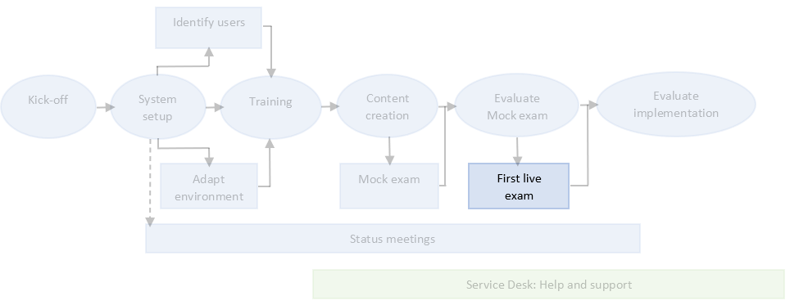
10 First live exam
Onboarding activity
Customer owned activity
Prepare for the first live exam by:
  Preparing and informing students
  Make sure the relevant test(s) has been created and activated
  Create fall-back procedures and process descriptions
  Inform and train invigilators

Slide 15
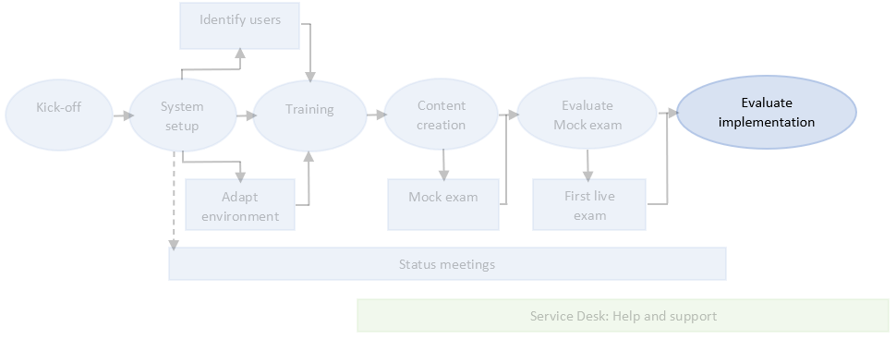
11 Evaluate onboarding
Onboarding activity
Customer owned activity
Evaluate the project
Perform evaluation activities for all staff involved in the project
Anything more that is needed to make sure the project runs successfully?
Handover to Customer Success

