Slide 1
Extensions in LIS
Gunnar Elfman
gunnar.elfman@gu.se

Slide 2
Background
This presentation is built on the experience we have from using LIS as a standardized format to exchanging information between systems within the higher education sector in Sweden
LIS is mainly used to syncronizing information between the providing system Ladok and various consuming systems

Slide 3
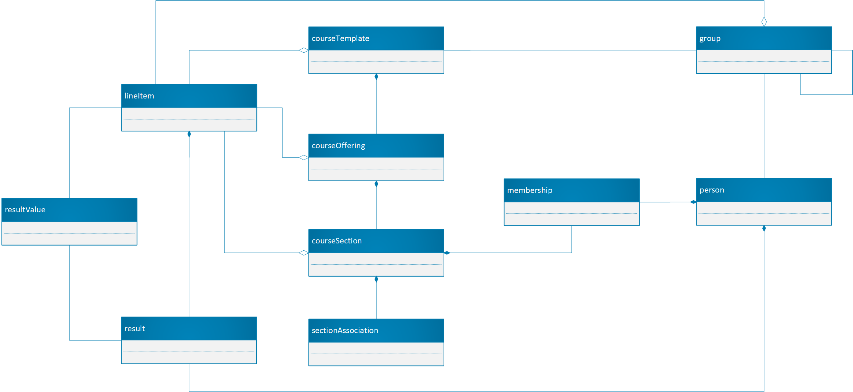
LIS information model as we see it

Slide 4

Mapping Ladok - LIS
Course Template
Ladok
Education Instance
Education Occasion
Education Occasion Period
Course Offering
Course Section
Organization
Student
Participation
Examination Occasion
Group
Person
Composite message
LineItem
Examination Result
Result

Slide 5
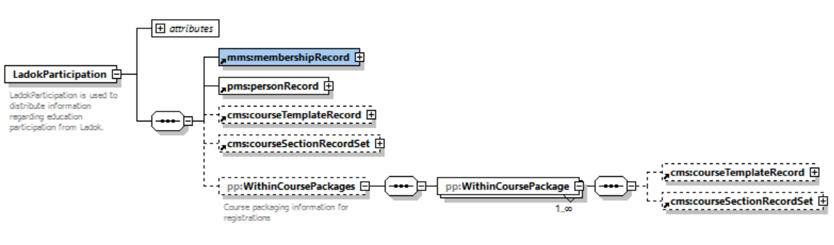
Education participation

Slide 6
Limitations for this presentation
This presentation covers only general extension handling in XML messages defined by XML-schema.
In general the same methodology can be used for JSON-messages, but that is not covered in this presentation.

Slide 7
Drivers for extension usage
Limited number of attributes for each object (~40%)
Language handling (~20%)
Attributes only represented by a text elements (~20%)
Need for complete parent objects (~20%)
  Enforce referential integrity

Slide 8
Drivers for extension usage
Limited number of attributes for each object
The majority of the required extensions are added due to the limited amount of attributes that is defined for each entity

Slide 9
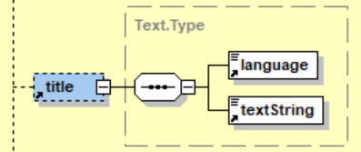
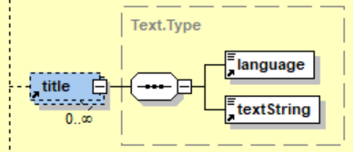
Drivers of extension usage
Language handling
Elements that represent titles, descriptions, etc. are not repeatable but qualified with language
Prefered solution for text elements that should allow language handling. Unbounded number of occurrences for elements with language qualifier

Slide 10
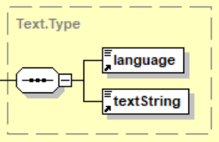
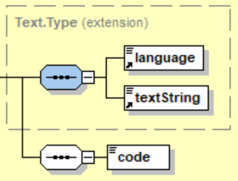
Drivers of extension usage
Attributes only represented by a text element
Most attributes are represented only as a text data type.
Number of extensions would decrease if a code value element was added for many attributes.

Slide 11

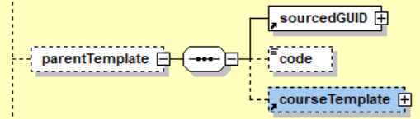
Drivers of extension usage
Need for complete parent objects
Parent objects are can only be represented with a reference.
An optional possibility to include a complete parent object would enable to enforce referential integrity without further enrichment
  Example from courseOffering

Slide 12
Identified issues
The usage of key-value pair as the base for extending LIS have some limiting drawbacks
  No possibility to have repeating extension elements
  No possibility to add complex and/or hierarchical extension

Slide 13
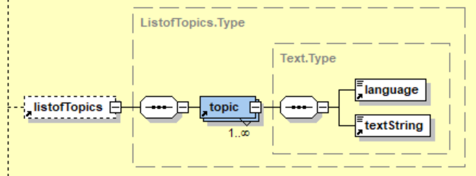
Identified issues: Repeating elements
The name-value pair way of implementing extensions does not support extension of repeatable complex elements.
Two main options
  Add extension points for all repeatable complex elements
  Extensions with references to the a specific instance of a repeatable complex element

Slide 14
Identified issues: complex and/or hierarchical extension
LIS Extensions can not easily include complex or hierarchical objects
E.g
  Lists
  Header-details structures
  etc

Slide 15
Extension list

Slide 16
Examples of messages with extensions
courseTemplate
courseSection

Slide 17
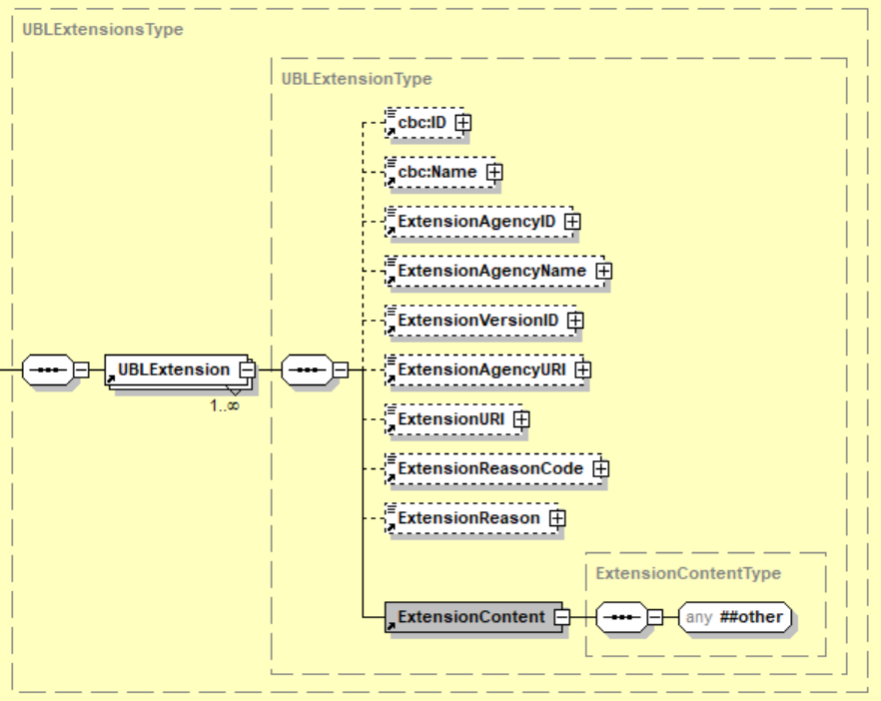
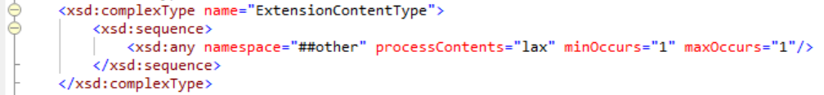
Exemple of extension handling in UBL
UBL, Universal Business Language
Extension meta data attached
Exists only on document top level
The extension must not belong to the same namespace as the root document

Slide 18
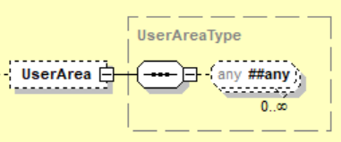
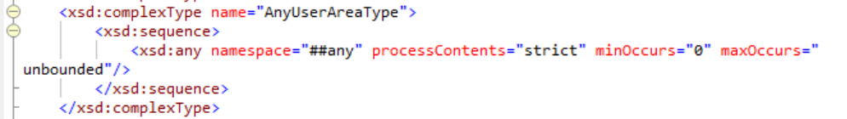
Exemple of extension handling in OAGIS
OAGIS, Open Application Group Integration Specification
No Metadata
Exists on all repeating complex elements
No namespace rules applied

